Slide 1
Data stage 8.7 Job Design
Any use, copying or distribution without written permission from UnitedHealth Group is prohibited.

Slide 2
History of Datastage
DataStage originated at VMark a spin off from Prime Computers during early 1996.
VMark acquired UniData in October 1997 and renamed itself to Ardent Software.
later in 1999 from Ardent Software DataStage was acquired by a company called Ascential Software.
In March 2005 IBM acquired Ascential Software and made DataStage part of the WebSphere family as WebSphere DataStage.
In 2006 the product was released as part of the IBM Information Server under the Information Management family but was still known as WebSphere DataStage.
In 2008 the suite was renamed to InfoSphere Information Server and the product was renamed to InfoSphere DataStage.
Any use, copying or distribution without written permission from UnitedHealth Group is prohibited.

Slide 3
Client Components

Slide 4
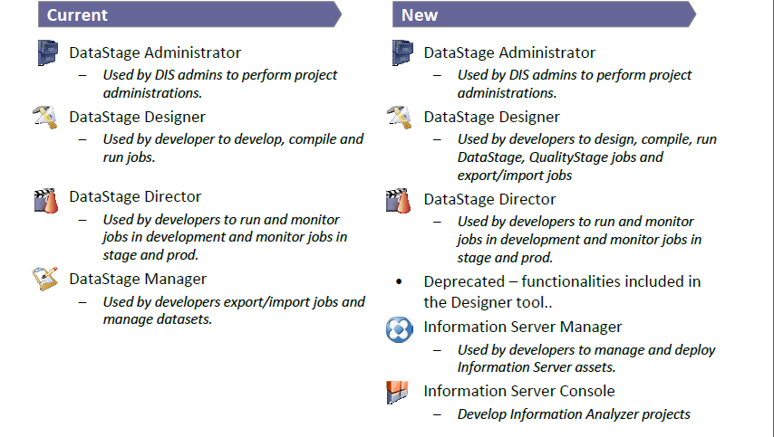
Development Tools
Any use, copying or distribution without written permission from UnitedHealth Group is prohibited.

Slide 5
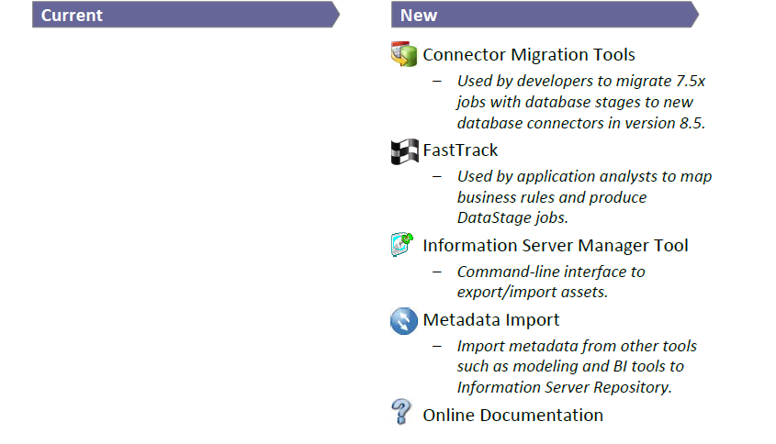
Development Tools
Any use, copying or distribution without written permission from UnitedHealth Group is prohibited.

Slide 6
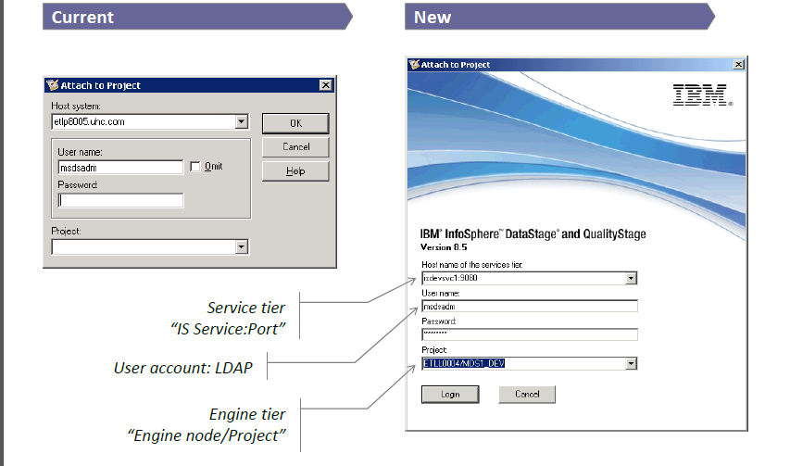
Log‐on Credentials
Any use, copying or distribution without written permission from UnitedHealth Group is prohibited.

Slide 7
Parallelism

Slide 8
Module Objectives
At the end of this module you will be able to:
  Understand the concept of parallelism in Datastage
  Types of Parallelism
  Understand Parallel Processing Environments
  Usage of Different types of Partitioning
Any use, copying or distribution without written permission from UnitedHealth Group is prohibited.

Slide 9
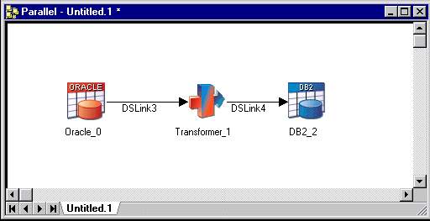
Parallelism
DataStage Parallel Extender brings the power of parallel processing to your data extraction and transformation applications.
Two basic types of parallel processing; pipeline and partitioning.
Any use, copying or distribution without written permission from UnitedHealth Group is prohibited.

Slide 10
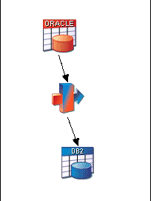
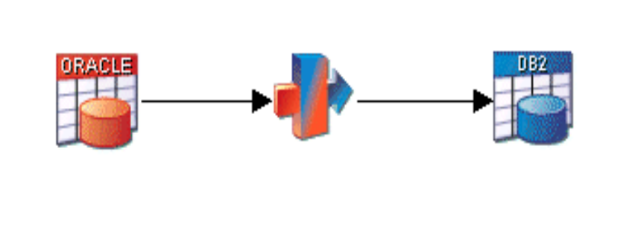
Parallelism vs No Parallelism
Time taken
Time taken
Conceptual representation of job running with no parallelism
pipeline parallelism
Any use, copying or distribution without written permission from UnitedHealth Group is prohibited.

Slide 11
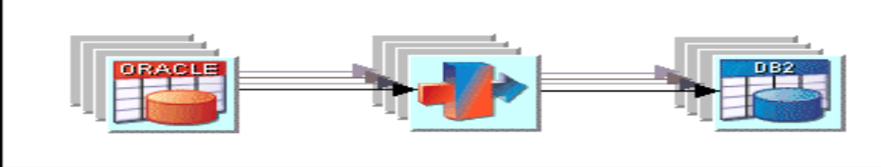
Partition Parallelism
Conceptual representation of job using partition parallelism
Partitioning parallelism means that entire record set is partitioned into small sets and processed on different nodes (logical processors).
Using partition parallelism the same job would effectively be run simultaneously by several processors, each handling a separate subset of the total data.
Any use, copying or distribution without written permission from UnitedHealth Group is prohibited.

Slide 12
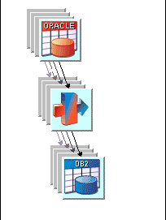
Combining Pipeline and Partition Parallelism
In this scenario you would have stages processing partitioned data and
filling pipelines.
Conceptual representation of job using pipeline and partition parallelism
Any use, copying or distribution without written permission from UnitedHealth Group is prohibited.

Slide 13
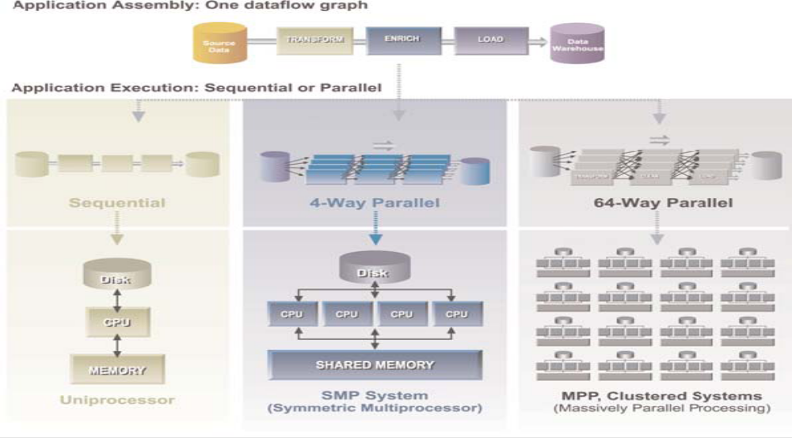
Parallel Processing Environments
Any use, copying or distribution without written permission from UnitedHealth Group is prohibited.

Slide 14
Parallel Processing Environments
The environment in which you run your DataStage jobs is defined by your system’s architecture and hardware resources. All parallel processing environments are categorized as one of:
  SMP (symmetric multiprocessing), in which some hardware resources may be shared among processors. The processors communicate via shared memory and have a single operating system.
  Cluster or MPP (massively parallel processing), also known as shared-nothing, in which each processor has exclusive access to hardware resources. The processors each have their own operating system, and communicate via a high-speed network.
Any use, copying or distribution without written permission from UnitedHealth Group is prohibited.

Slide 15
Different types of Partitioning
Aim of most partitioning operations is to end up with a set of partitions that are as near equal size as possible, ensuring an even load across your processors
If you are using an aggregator stage to summarize your data. To get the answers you want (and need) you must ensure that related data is grouped together in the same partition before the summary operation is performed on that partition.
Any use, copying or distribution without written permission from UnitedHealth Group is prohibited.

Slide 16
Different types of Partitioning – Round Robin
  The first record goes to the first processing node, the second to the second processing node, and so on.
  When DataStage reaches the last processing node in the system, it starts over.
  It creates approximately equal-sized partitions.
  It is used when DataStage initially partitions data.
Any use, copying or distribution without written permission from UnitedHealth Group is prohibited.

Slide 17
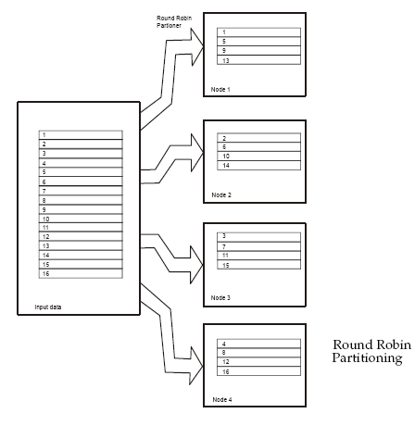
Different types of Partitioning – Round Robin
Any use, copying or distribution without written permission from UnitedHealth Group is prohibited.

Slide 18
Different types of Partitioning – Random
  Records are randomly distributed across all processing nodes.
  It rebalances the partitions of an input data set to guarantee that each processing node receives an approximately equal-sized partition.
  It has slightly higher overhead than round robin because of the extra processing required to calculate a random value for each record.
Any use, copying or distribution without written permission from UnitedHealth Group is prohibited.

Slide 19
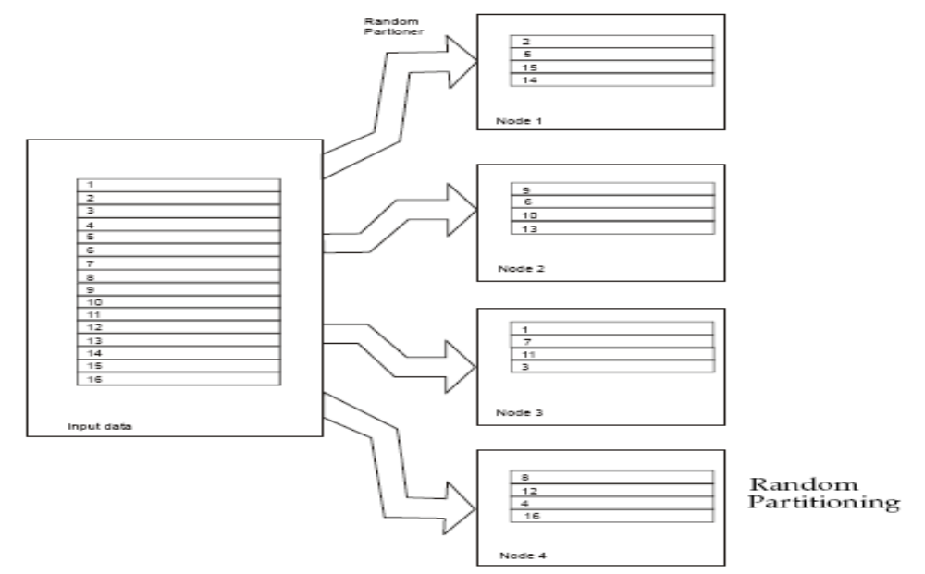
Different types of Partitioning – Random
Any use, copying or distribution without written permission from UnitedHealth Group is prohibited.

Slide 20
Different types of Partitioning – Same
  The operator using the data set as input performs no repartitioning and takes as input the partitions output by the preceding stage.
  The records stay on the same processing node, that is, they are not redistributed.
  It is the fastest partitioning
  DataStage uses when passing data between stages in your job.
Any use, copying or distribution without written permission from UnitedHealth Group is prohibited.

Slide 21
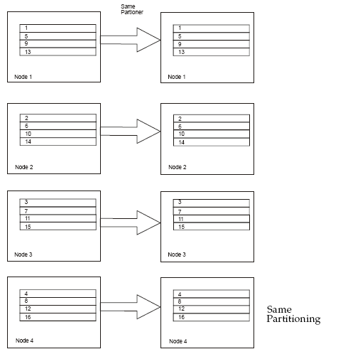
Different types of Partitioning – Same
Any use, copying or distribution without written permission from UnitedHealth Group is prohibited.

Slide 22
Different types of Partitioning – Entire
  Every instance of a stage on every processing node receives the complete data set as input.
  Every instance of the operator needs access to the entire input data set.
  This partitioning method is used with stages that create lookup tables from their input.
Any use, copying or distribution without written permission from UnitedHealth Group is prohibited.

Slide 23
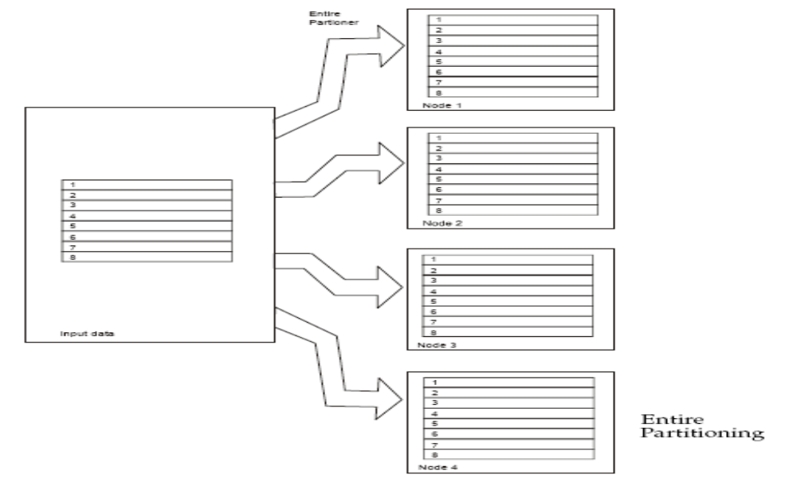
Different types of Partitioning – Entire
Any use, copying or distribution without written permission from UnitedHealth Group is prohibited.

Slide 24
Different types of Partitioning – Hash
  In hash partitioning one or more fields of each input record are taken as the hash key fields.
  Records with the same values for all hash key fields are assigned to the same processing node.
  It is useful for ensuring that related records are in the same partition, which may be a prerequisite for a processing operation.
  For a remove duplicates operation, you can hash partition records so that records with the same partitioning key values are on the same node.
  The records can be sorted on each node using the hash key fields as sorting key fields, then remove duplicates, again using the same keys.
  Hash partitioning does not necessarily result in an even distribution of data between partitions.
Any use, copying or distribution without written permission from UnitedHealth Group is prohibited.

Slide 25
Different types of Partitioning – Modulus
  Partitioning is based on a key column modulo the number of partitions.
  It is similar to hash by field, but involves simpler computation\
  The partition number of each record is calculated as follows:
partition_number = fieldname mod number_of_partitions
fieldname is a numeric field of the input data set.
number_of_partitions is the number of processing
nodes.
Any use, copying or distribution without written permission from UnitedHealth Group is prohibited.

Slide 26
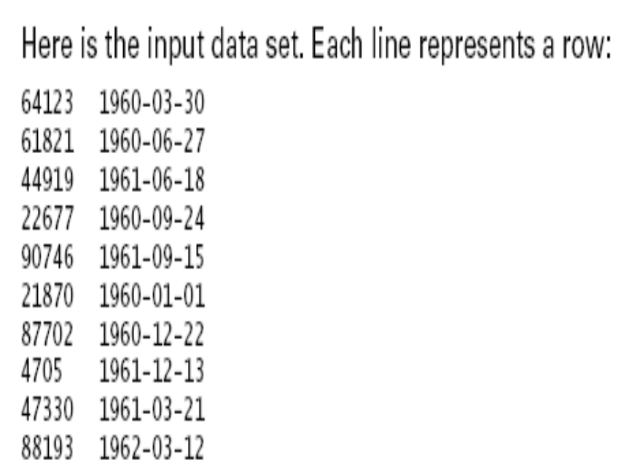
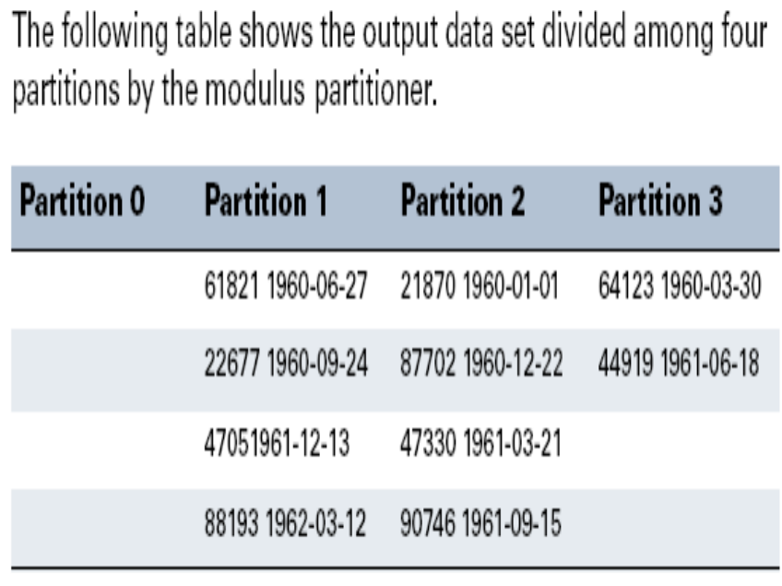
Different types of Partitioning – Modulus
Any use, copying or distribution without written permission from UnitedHealth Group is prohibited.

Slide 27
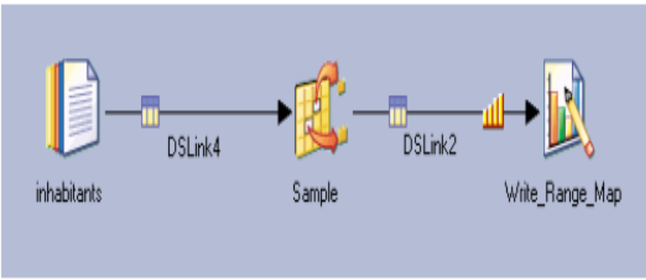
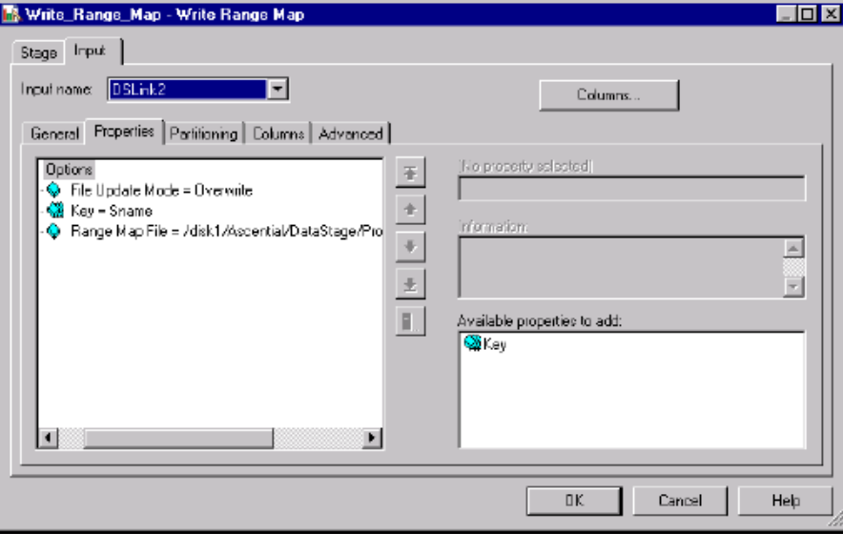
Different types of Partitioning – Range
  Divides a data set into approximately equal-sized partitions, each of which contains records with key columns within a specified range.
  A range partitioner divides a data set into approximately equal size partitions based on one or more partitioning keys.
  A range map is created using the Write Range Map stage.
Any use, copying or distribution without written permission from UnitedHealth Group is prohibited.

Slide 28
Different types of Partitioning – DB2 and Auto
DB2
  Partitions an input data set in the same way that DB2 would partition it.
Auto
  The most common method you will see on the DataStage stages.
  Typically DataStage would use round robin when initially partitioning data, and same for the intermediate stages of a job.
Any use, copying or distribution without written permission from UnitedHealth Group is prohibited.

Slide 29
Module : Sequential File Stage

Slide 30
Module Objectives
You will learn to:
  Import sequential files into the EE Framework
  Utilize parallel processing techniques to increase sequential file access
  Understand usage of the Sequential, DataSet, FileSet, and LookupFileSet stages
  Manage partitioned data stored by the Framework
Notes:
In this module students will concentrate their efforts on sequential file access in Enterprise Edition jobs.

Slide 31
Types of Sequential Data Stages
Sequential
  Fixed or variable length
File Set
Lookup File Set
Data Set
Notes:
Several stages handle sequential data. Each stage as both advantages and differences from the other stages that handle sequential data.
Sequential data can come in a variety of types -- including both fixed length and variable length.

Slide 32
Sequential Stage Introduction
The EE Framework processes only datasets
For files other than datasets, such as flat files, Enterprise Edition must perform import and export operations – this is performed by import and export OSH operators generated by Sequential or FileSet stages
During import or export DataStage performs format translations – into, or out of, the EE internal format
Data is described to the Framework in a schema
Notes:
The DataStage sequential stage writes OSH – specifically the import and export Orchestrate operators.
Q: Why import data into an Orchestrate data set?
A: Partitioning works only with data sets. You must use data sets to distribute data to the multiple processing nodes of a parallel system.
Every Orchestrate program has to perform some type of import operation, from: a flat file, COBOL data, an RDBMS, or a SAS data set. This section describes how to get your data into Orchestrate.
Also talk about getting your data back out. Some people will be happy to leave data in Orchestrate data sets, while others require their results in a different format.

Slide 33
How the Sequential Stage Works
Generates Import/Export operators, depending on whether stage is source or target
Performs direct C++ file I/O streams
Notes:
Behind each parallel stage is one or more Orchestrate operators. Import and Export are both operators that deal with sequential data.

Slide 34

Using the Sequential File Stage
Both import and export of general files (text, binary) are performed by the SequentialFile Stage.
Data import:
Data export
Importing/Exporting Data
EE internal format
EE internal format
Notes:
When data is imported the imported operator translates that data into the Enterprise Edition internal format. The export operator performs the reverse action.

Slide 35
Working With Flat Files
Sequential File Stage
  Normally will execute in sequential mode
  Can be parallel if reading multiple files (file pattern option)
  Can use multiple readers within a node on fixed width file
  DSEE needs to know
    How file is divided into rows
    How row is divided into columns
Notes:
Both export and import operators are generated by the sequential stage -- which one you get depends on whether the sequential stage is used as source or target.

Slide 36
Processes Needed to Import Data
Recordization
  Divides input stream into records
  Set on the format tab
Columnization
  Divides the record into columns
  Default set on the format tab but can be overridden on the columns tab
  Can be “incomplete” if using a schema or not even specified in the stage if using RCP
Notes:
These two processes must want together to correctly interpret data -- that is, to break a data string down into records and columns.

Slide 37
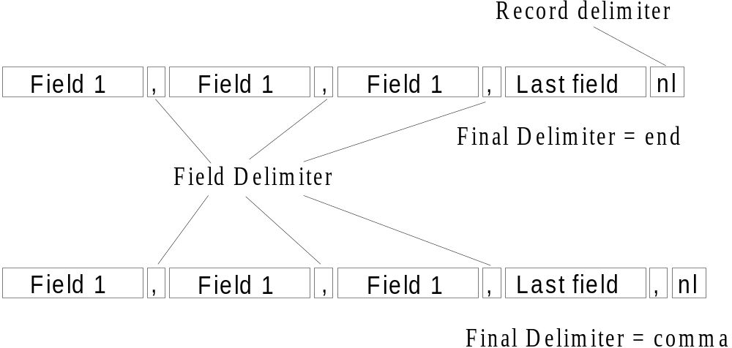
File Format Example
Notes:
Fields all columns are defined my delimiters. Similarly, records are defined by terminating characters.

Slide 38
Sequential File Stage
To set the properties, use stage editor
  Page (general, input/output)
  Tabs (format, columns)
Sequential stage link rules
  One input link
  One output links (except for reject link definition)
  One reject link
    Will reject any records not matching meta data in the column definitions
Notes:
The DataStage GUI allows you to determine properties that will be used to read and write sequential files.

Slide 39
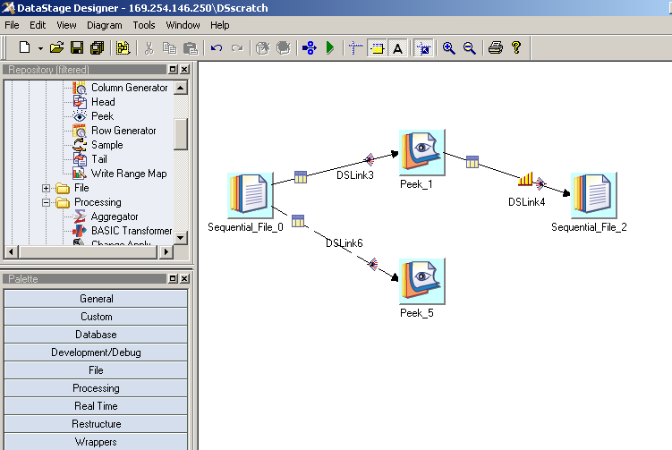
Job Design Using Sequential Stages
Stage categories
Notes:
Source stage
Multiple output links - however, note that one of the links is represented by a broken line. This is a reject link, not to be confused with a stream link or a reference link.
Target
One input link

Slide 40
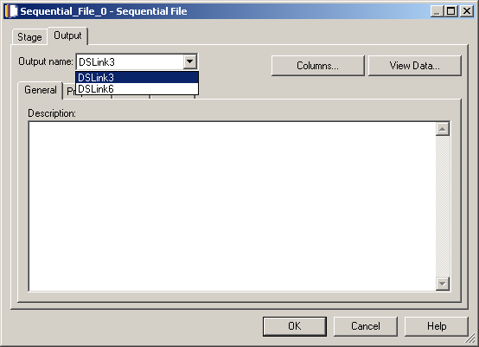
General Tab – Sequential Source
Multiple output links
Show records
Notes:
If multiple links are present you'll need to down-click to see each.

Slide 41
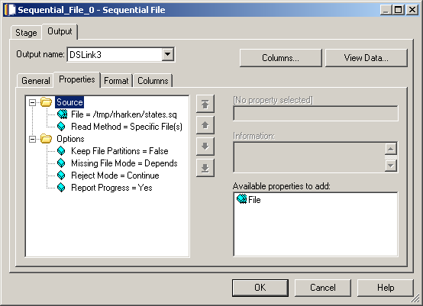
Properties – Multiple Files
Click to add more files having the same meta data.
Notes:
If specified individually, you can make a list of files that are unrelated in name.
If you select “read method” and choose file pattern, you effectively select an undetermined number of files.

Slide 42
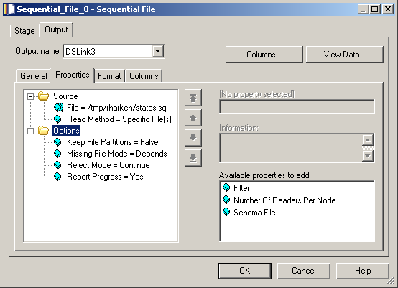
Properties - Multiple Readers
Multiple readers option allows you to set number of readers
Notes:
To use multiple readers on a sequential file, must be fixed-length records.

Slide 43
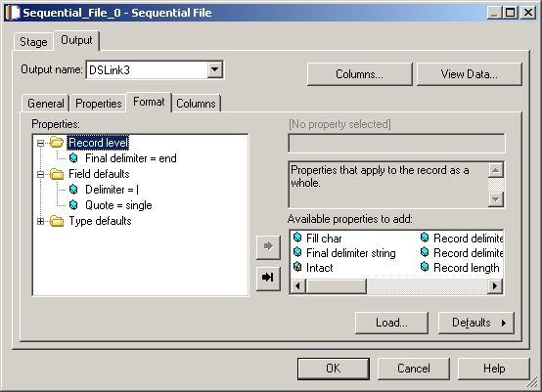
Format Tab
File into records
Record into columns
Notes:
DXEE needs to know:
How a file is divided into rows
How a row is divided into columns
Column properties set on this tab are defaults for each column; they can be overridden at the column level (from columns tab).

Slide 44
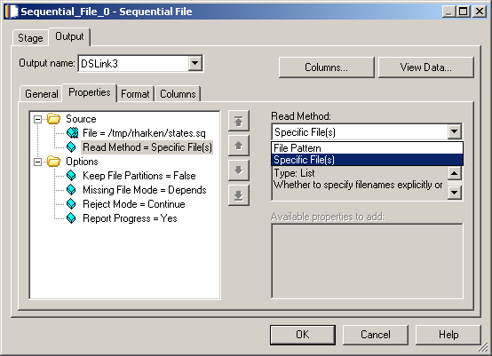
Read Methods

Slide 45
Reject Link
Reject mode = output
Source
  All records not matching the meta data (the column definitions)
Target
  All records that are rejected for any reason
Meta data – one column, datatype = raw
Notes:
The sequential stage can have a single reject link. This is typically used when you are writing to a file and provides a location where records that have failed to be written to a file for some reason can be sent. When you are reading files, you can use a reject link as a destination for rows that do not match the expected column definitions.

Slide 46

File Set Stage
Can read or write file sets
Files suffixed by .fs
File set consists of:
  Descriptor file – contains location of raw data files + meta data
  Individual raw data files
Can be processed in parallel
Notes:
Number of raw data files depends on: the configuration file – more on configuration files later.

Slide 47

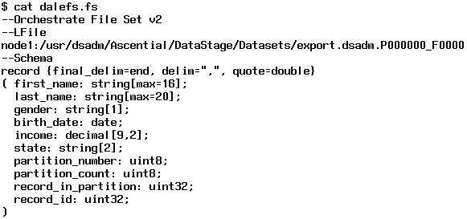
File Set Stage Example
Descriptor file
Notes:
The descriptor file shows both a record is metadata and the file's location. The location is determined by the configuration file.

Slide 48
File Set Usage
Why use a file set?
  2G limit on some file systems
  Need to distribute data among nodes to prevent overruns
  If used in parallel, runs faster that sequential file
Notes:
File sets, lower yielding faster access and simple text files, are not in the Enterprise Edition internal format.

Slide 49
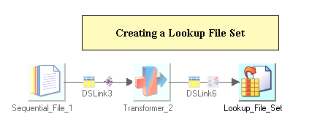
Lookup File Set Stage
Can create file sets
Usually used in conjunction with Lookup stages
Notes:
The lookup file set is similar to the file set but also contains information about the key columns. These keys will be used later in lookups.

Slide 50
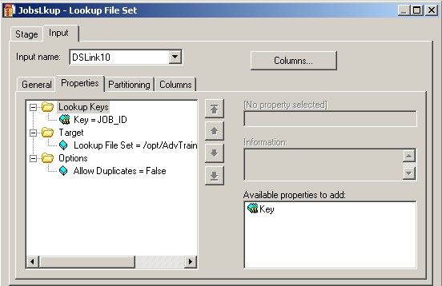
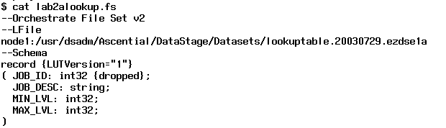
Lookup File Set > Properties
Key column specified
Key column dropped in descriptor file

Slide 51

Data Set
Operating system (Framework) file
Suffixed by .ds
Referred to by a control file
Managed by Data Set Management utility from GUI (Manager, Designer, Director)
Represents persistent data
Key to good performance in set of linked jobs
Notes:
Data sets represent persistent data maintained in the internal format.

Slide 52
Persistent Datasets
Accessed from/to disk with DataSet Stage.
Two parts:
  Descriptor file:
    contains metadata, data location, but NOT the data itself
  Data file(s)
    contain the data
    multiple Unix files (one per node), accessible in parallel
input.ds
record (
partno: int32;
description: string;
)
node1:/local/disk1/…
node2:/local/disk2/…
Notes:
Accessed from/to disk with DataSet Stage. Two parts:
Descriptor file
User-specified name
Contains table definition ("unformatted core" schema)
Here is the icon of the DataSet Stage, used to access persistent datsets
Descriptor file, e.g., "input.ds" contains:
Paths of data files
Metadata: unformatted table definition, no formats (unformatted schema)
Config file used to store the data
Data file(s)
Contain the data itself
System-generated long file names, to avoid naming conflicts.

Slide 53


Data Set Stage
Is the data partitioned?
Notes:
In both cases the answer is Yes.

Slide 54
Engine Data Translation
Occurs on import
  From sequential files or file sets
  From RDBMS
Occurs on export
  From datasets to file sets or sequential files
  From datasets to RDBMS
Engine most efficient when processing internally formatted records (I.e. data contained in datasets)

Slide 55
Managing DataSets
GUI (Manager, Designer, Director) – tools > data set management
Alternative methods
  Orchadmin
    Unix command line utility
    List records
    Remove data sets (will remove all components)
  Dsrecords
    Lists number of records in a dataset
Notes:
Both dsrecords and orchadmin are Unix command-line utilities.
The DataStage Designer GUI provides a mechanism to view and manage data sets.

Slide 56
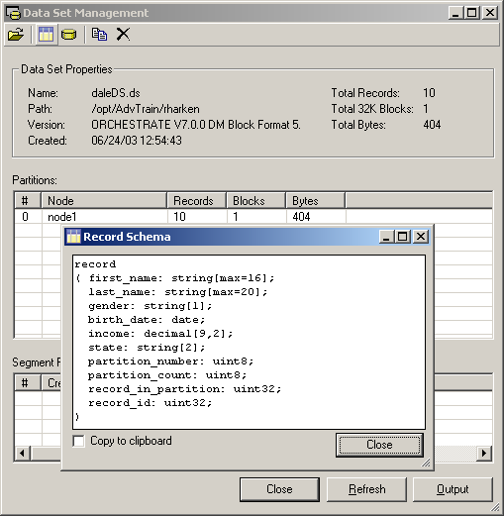
Data Set Management
Display data
Schema
Notes:
The screen is available (data sets management) from manager, designer, and director.

Slide 57
Data Set Management From Unix
Alternative method of managing file sets and data sets
  Dsrecords
    Gives record count
      Unix command-line utility
      $ dsrecords ds_name
      I.e.. $ dsrecords myDS.ds
        156999 records
  Orchadmin
    Manages EE persistent data sets
      Unix command-line utility
      I.e. $ orchadmin rm myDataSet.ds

Slide 58
DataStage Data Types
Standard Types
Char
VarChar
Integer
Decimal (Numeric)
Floating Point
Date
Time
Timestamp
VarBinary (raw)
Complex Types
Vector (array, occurs)
Subrecord (group)

Slide 59
Standard Types
Char – Fixed length string
Varchar – Variable length string, Specify maximum length
Integer
Decimal (Numeric) – Precision, Scale – e.g. (10,2) means 8 digits before the decimal point and 2 after the decimal point
Floating Point
Date – Default string format %yyyy-%mm-%dd
Time – Default string format %hh:%nn:%ss
Timestamp – Default string format
%yyyy-%mm-%dd %hh:%nn:%ss
VarBinary (raw)

Slide 60
Complex Data Types
Vector
  A one-dimensional array
  Elements are numbered 0 to n
  Elements can be of any single type
  All elements must have the same type
  Can have fixed or variable number of elements
Subrecord
  A group or structure of elements
  Elements of the subrecord can be of any type
  Subrecords can be embedded

Slide 61
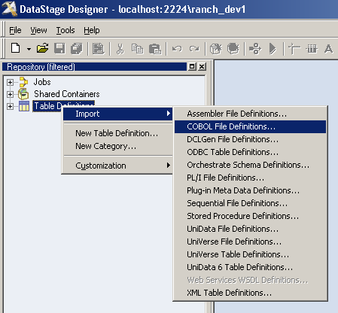
Importing schema with Complex types
Right Click Table Definitions in Designer
Go to Import> COBOL File Definitions

Slide 62
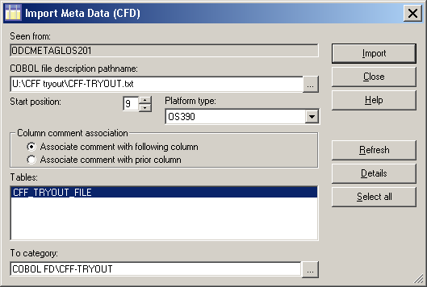
Importing COBOL copybooks
Path to copybook file
Where to store the Table Definition
Start Position of copybook: 9

Slide 63
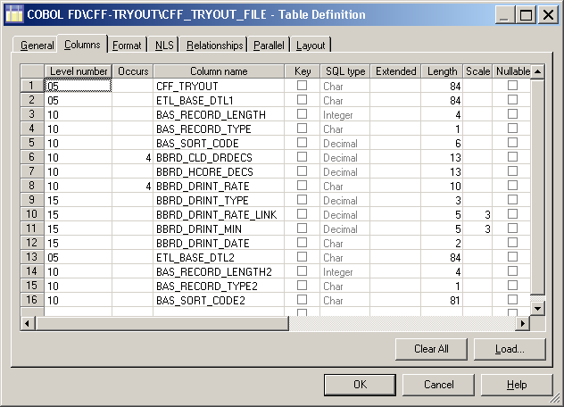
Complex Types Column Definitions
Subrecord
Elements of subrecord
Vector

Slide 64

Complex Flat File Stage
The Complex Flat File Stage is used to read a file or write a file.
When used as a source, the stage allows you to read data from one of more complex flat files, including MVS datasets with QSAM and VSAM files. A complex flat file may contain one or more GROUPs, REDEFINES, OCCURS, or OCCURS DEPENDING ON clauses.
When used as a target, the stage allows you to write data to one or more complex flat files. It does not write to MVS datasets.
The stage can have a single input link or a single output link, as well as a single reject link.

Slide 65
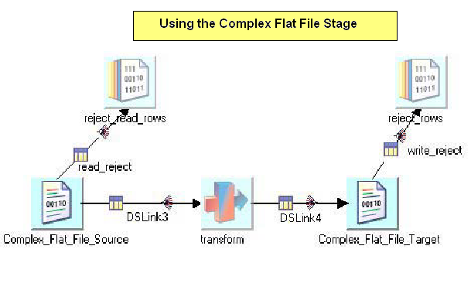
Complex Flat File Stage Usage

Slide 66
CFF Stage Editor
Stage page: This is always present and is used to specify general information about the stage, including details about the file or files being read from or written to.
Input Page: This is present when you are writing to a complex flat file. It allows you to specify details about how data should be written to the target file, including partitioning and buffering information.
Output page: This is present when you are reading from a complex flat file. It allows you to select columns for output and to change the default buffering settings on the output link if desired.

Slide 67
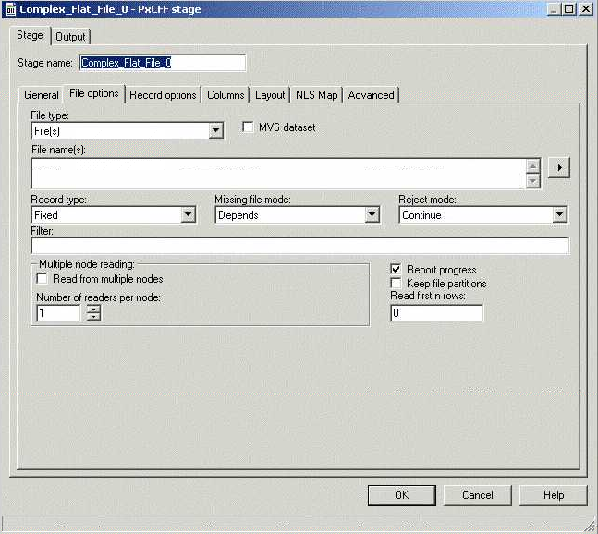
Complex Flat File Stage UI (Source)

Slide 68
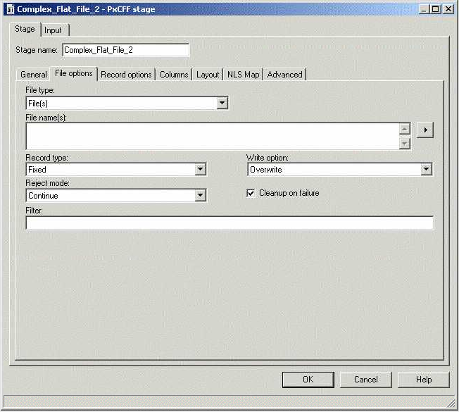
Complex Flat File Stage UI (Target)

Slide 69

Lookup File Set Stage
The Lookup File Set stage is used to create a lookup file set or a reference one for a lookup.
The stage can have a single input link and a single output link, the output link must be a reference link.

Slide 70
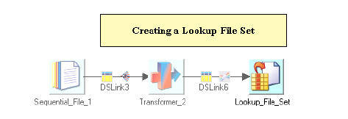
Lookup File Set Stage Usage

Slide 71
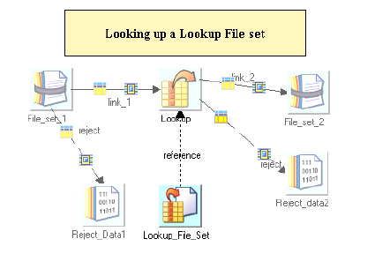
Lookup File Set Stage Usage

Slide 72
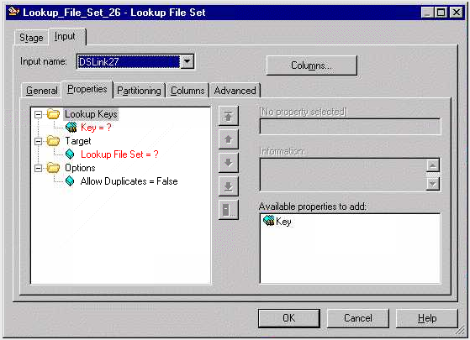
Lookup File Set Stage UI (Input Link)

Slide 73
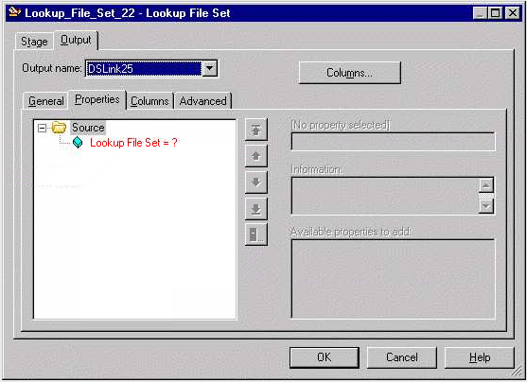
Lookup File Set Stage UI (Output Link)

Slide 74

SAS Data Set Stage
The SAS Data Set stage is used to read data from or write data to a parallel SAS Data Set in conjunction with an SAS stage.
DataStage uses a parallel SAS data set to store data being operated on by an SAS stage in a persistent form. A parallel SAS data set is a set of one or more sequential SAS data sets, with a header file specifying the names and locations of all the component files. By convention, the header file has the suffix .psds.
The stage can have a single input link and a single output link.

Slide 75
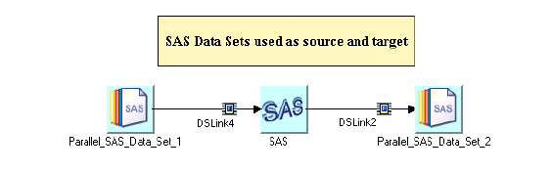
SAS Data Sets Stage Usage

Slide 76
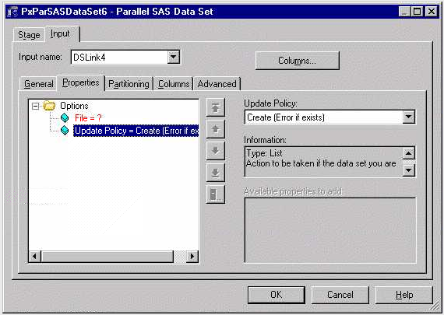
SAS Data Set Stage UI (Input Link)

Slide 77
Module Objectives
Introduction
Properties
Format
Stage as a target
Advanced properties
Examples
Any use, copying or distribution without written permission from UnitedHealth Group is prohibited.

Slide 78

Funnel Stage
The Funnel stage copies multiple input data sets to a single output data set.
This operation is useful for combining separate data sets into a single large data set.
The stage can have any number of input links and a single output link.

Slide 79
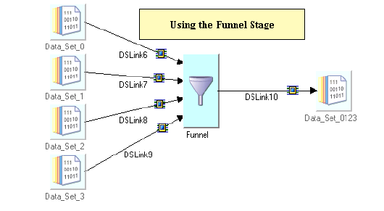
Funnel Stage Usage

Slide 80
Funnel Modes
The Funnel stage can operate in one of three modes:
Continuous Funnel: combines the records of the input data in no guaranteed order. It takes one record from each input link in turn. If data is not available on an input link, the stage skips to the next link rather than waiting.
Sort Funnel: combines the input records in the order defined by the value(s) of one or more key columns and the order of the output records is determined by these sorting keys
Sequence: copies all records from the first input data set to the output data set, then all the records from the second input data set, and so on.
Note: For all methods the meta data of all input data sets must be identical.

Slide 81
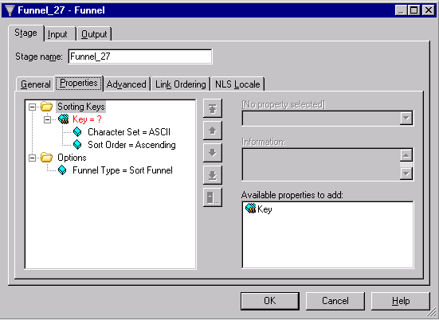
Funnel Stage UI - Properties

Slide 82
Funnel Stage – Sorting/Partitioning
The sort funnel method has some particular requirements about its input data. All input data sets must be sorted by the same key columns as used by the Funnel operation.
Typically all input data sets for a sort funnel operation are hash-partitioned before they’re sorted (choosing the (auto) partitioning method will ensure that this is done). Hash partitioning guarantees that all records with the same key column values are located in the same partition and so are processed on the same node. If sorting and partitioning are carried out on separate stages before the Funnel stage, this partitioning must be preserved.

Slide 83

Filter Stage
The Filter stage transfers, unmodified, the records of the input data set which satisfy the specified requirements and filters out all other records.
You can specify different requirements to route rows down different output links.
The filtered out records can be routed to a reject link, if required.
It can have a single input link and a any number of output links and, optionally, a single reject link.

Slide 84
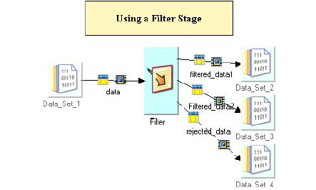
Filter Stage Usage

Slide 85
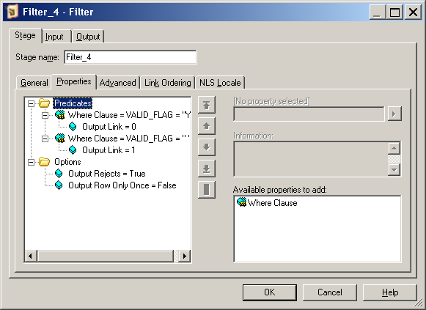
Filter Stage UI - Properties
Multiple filter conditions

Slide 86
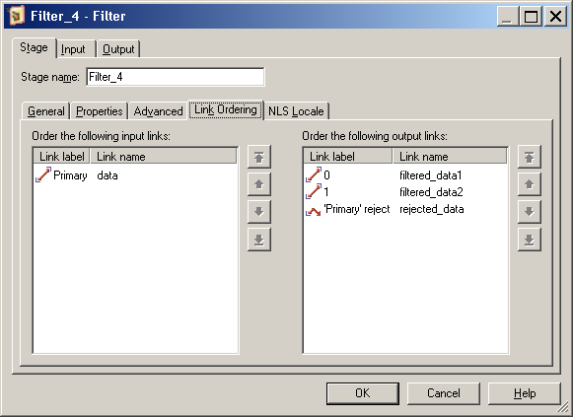
Filter Stage UI – Link ordering
Multiple filter conditions – link mapping

Slide 87
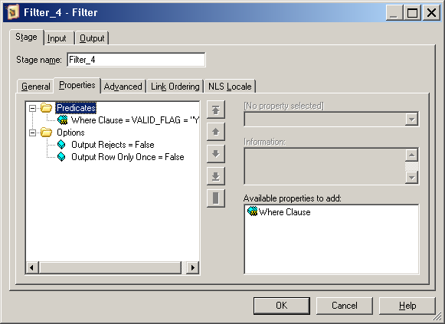
Filter Stage UI – Single condition
Single filter condition – link # not required

